Slide 1
Tic Tac Toe
Shreenidhi Sudhakar

Slide 2
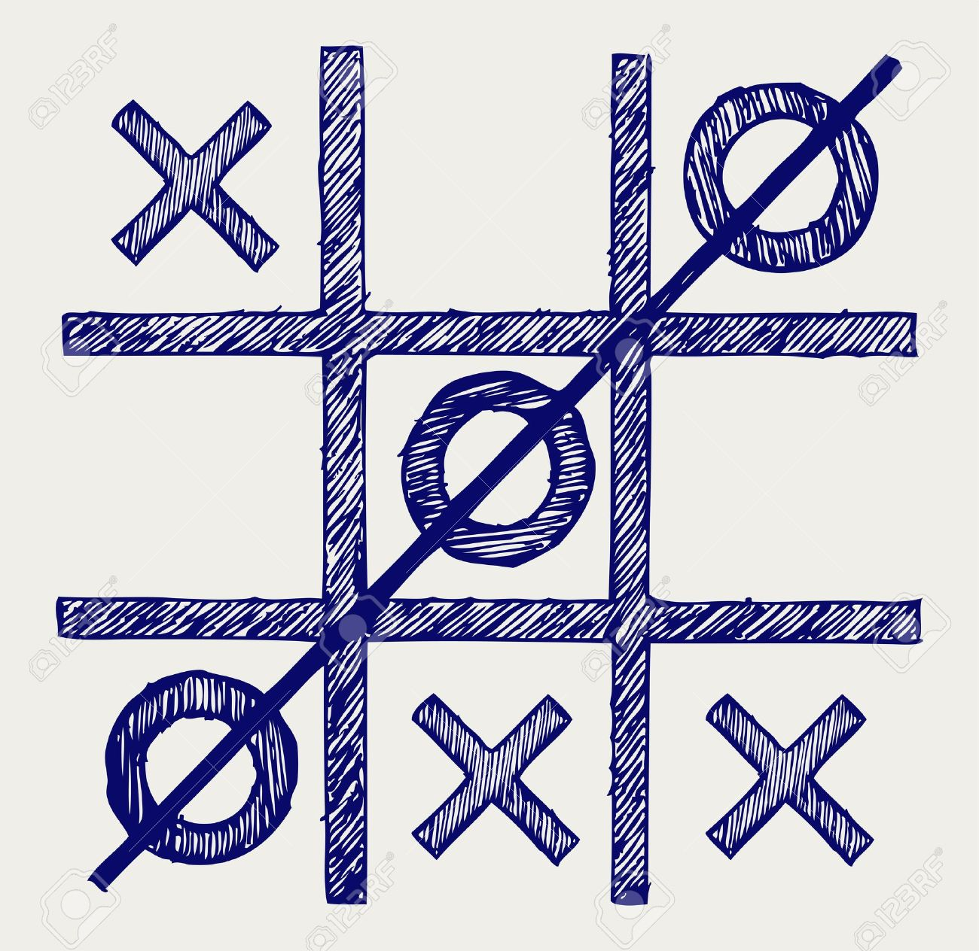
Game Design
Board Position:
0 | 1 | 2 Player uses O
3 | 4 | 5 Computer uses X
6 | 7 | 8
Board States:
Teacher Mode
Pre-defined Board States
Accuracy is good
No Teacher Mode
Random Board States
Accuracy is poor

Slide 3
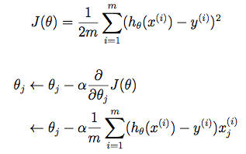
Least Mean Squares
Cost Function
Gradient Update

Slide 4
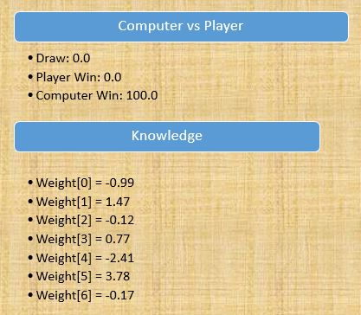
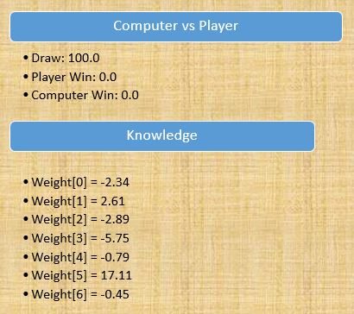
Results
Teacher Mode
No Teacher Mode

Slide 5
Real Time Applications
Gaming
Real Estate
Stock Market

Slide 6
Thank You
Check Out: shreenidhi.azurewebsites.net

